Slide 1
TRADE PARTNERS
Credentials
November 2017

Slide 2




Smollan trade partners ownership structure
Over 80 years field marketing experience
Operating over 5 continents
Employing over 70,000 staff
Networked extensively into the Australian Grocery Market
Deep understanding of what manufacturers & retailers value
Australasia’s leading marketing content & communications group
ASX Listed since 1993
Formally John Singleton Advertising

Slide 3
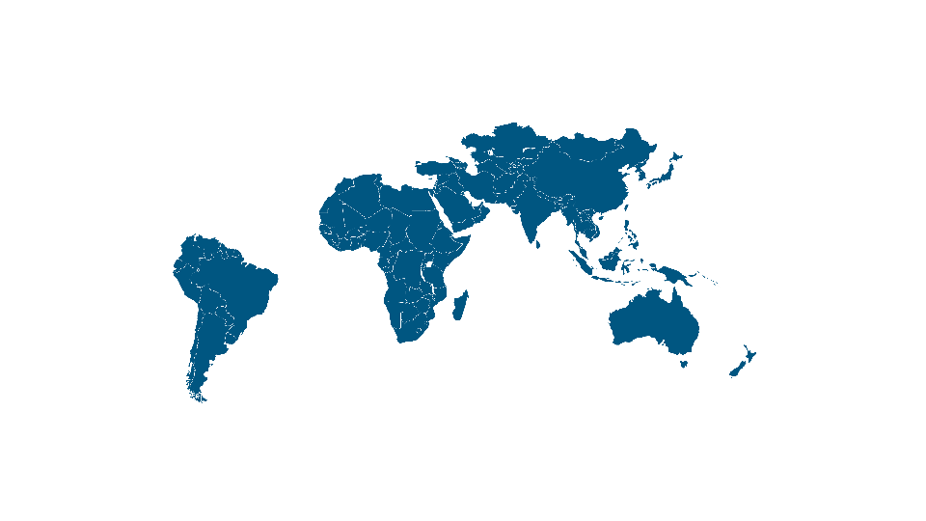

SMOLLAN GEOGRAPHICAL FOOTPRINT IN AUSTRALIA, ASIA, AFRICA AND THE MIDDLE EAST
Kenya
Ethiopia
UAE
India
Pakistan
China
Myanmar
Taiwan
Thailand
Vietnam
Malaysia
Singapore
Brazil
Namibia
Botswana
South Africa
Lesotho
Swaziland
Zimbabwe
Zambia
Australia

Slide 4
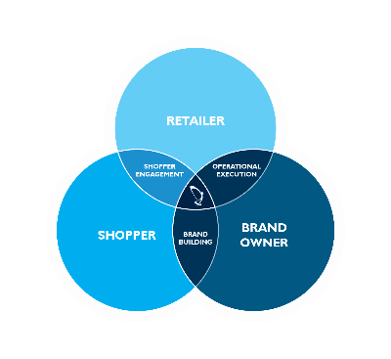
Market Position
OUR PURPOSE We create and execute leading retail solutions that deliver growth and in doing so have a profound social impact.
Smollan is a leading international retail solutions company. Through strategic partnerships with like-minded retail solutions companies, we are able to offer a seamless service internationally. Some of these partners are shown on pages 9-10.
We deliver growth for our clients by covering every aspect of how their brand is managed at the point of purchase. Our people execute brand strategies in store for many of the world’s most loved brands.
We pride ourselves in partnering with our clients to achieve growth through increasing breadth and depth of distribution and driving sales by creating exceptional shopper experiences. We are the pivot point where the retailer, brand owner and shopper intercept.

Slide 5





1931
1975
2010
2017
1 Employee
135 Employees
32 858 Employees
70 000+ Employees
The Smollan business is started as a regional sales agency by Fred Smollan.
Smollan takes on more clients and commences its expansion into a national business.
Smollan continues it’s growth in SA and embarks on establishing relationships with key strategic partners across the world.
Smollan in an international retail solutions company servicing brands and retailers across 5 continents.

Slide 6

Smollan partners
In 2009, WPP, one of the world’s leading communications services groups, became both an investor and a strategic partner of Smollan. This partnership has assisted us in extending our footprint as well as establishing relationships with businesses and people in the WPP network. WPP offer a whole set of capabilities which are complementary to field execution. WPP companies provide creative advertising, research, insights, panel data, public relations, digital, CRM and shopper marketing across the range of brands.
Trade Partners is a leader in Relationship & Account Management Services within the Australian Grocery Trade. Managing hundreds of lines with retail sales close exceeding $200mil across the key retail group of Woolworths, Coles & Independent Supermarkets.
The business is extensively networked from Buying to Senior Management throughout the trade, providing fast insights to industry trends.
In 2016 Trade Partners and Smollan joined forces in Australia to create a field servicing company that truly understood client and retailer needs.

Slide 7


SMOLLAN PARTNERS
DKSH is the No. 1 Asian-focused market expansion services group. Jointly, we provide a more comprehensive marketing and sales coverage of consumer products outlets in Asia than any other service provider.
Advantage is North America’s leading provider of sales and marketing solutions. Smollan and Advantage Solutions have formed a strategic international partnership that will leverage best practices globally, adding scale and reach to form deeper, broader strategic partnerships with clients including a unified solution for Europe.

Slide 8
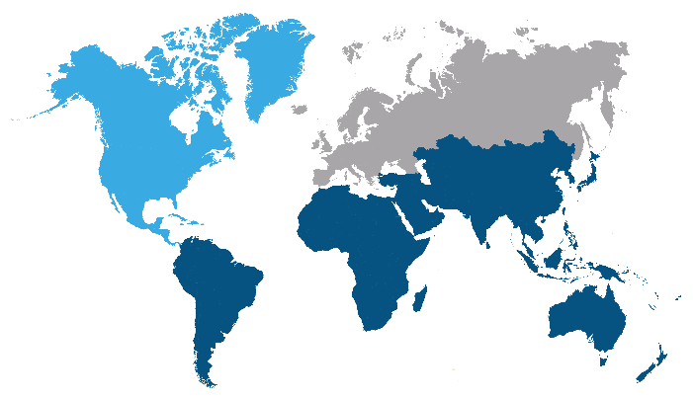


COLLABRATIVE RELATIONSHIP FOR GLOBAL EXPANSION
Existing
New territory pipeline
Acquisitions in existing

Slide 9





CORE COMPETENCIES
Inspired Talent
Brilliant
Relationships
Leading Solutions
Operational Excellence

Slide 10

Core competencies
Inspired Talent
Training building blocks from Merchandiser to CEO
Performance manage
Compliance to all legislation
Reward and recognition focused
Career development
Focusing on key talent from FMCG
Targeting the universities
International development programs

Slide 11

core competencies
Brilliant Relationships
Client and Customer Relationships
True Partnerships & Shared Vision
Continual Growth
Multi-level Contact Strategy
Mutual Objectives
Global initiatives
Review and Performance based culture
Shared Best Practice
Track Record of Successful Partnerships

Slide 12

core competencies
Leading Solutions
Insights drive actions
In house development team for customisation
Real time data and live dashboards
Practical and user friendly system based on almost a century
of operations
Fully mobile on all platforms with a basket of services
International best practice

Slide 13

core competencies
Operational Excellence
Almost a century of experience
Deep investment into the science of execution
Continual learning from
international best practice
Diverse range of services and ability to integrate seamlessly
Focus on operational culture tied to variable pay
Retailer relationships
Unparalleled global footprint
Real time attendance and movement of all staff

Slide 14




integrated retail solutions
FIELD SALES & RETAIL EXECUTION
ACTIVATION
INFORMATION & TECHNOLOGY
In Stock, On Shelf, All The Time
Creatively Inspiring Brand Choice
Measure, Manage, OptImise
STRATEGIC ASSETS
& CAPABILITIES:
Mobile data capture | Store Universe monitoring | Image recognition/planogram compliance
Crowd sourcing | Dashboarding | Store profiling | Assortment optimisation | Space planning
Time and motion analysis | Campaign scheduling

Slide 15







INTERGRATED RETAIL SOLUTIONS | FIELD SALES & RETAIL EXECUTION
SURGE MERCHANDISING
FIELD SALES
MERCHANDISING & PLANOGRAMS
CROWD SOURCED MERCHANDISING
FIELD SALES & RETAIL EXECUTION
In Stock, On Shelf, All The Time
POINT OF PURCHASE EXECUTION
ON DEMAND RECRUITMENT

Slide 16







INTERGRATED RETAIL SOLUTIONS | ACTIVATION
POINT OF SALE
MANAGEMENT
DEMO EXECUTION
SHOPPER ENGAGEMENT
KITTING & GIFTING
ACTIVATION
SPEED TO MARKET
Creatively Inspiring Brand Choice
DIGITAL COUPONS

Slide 17








INTERGRATED RETAIL SOLUTIONS | INFORMATION & TECHNOLOGY
GPS
SALES FORCE AUTOMATION
BUSINESS INTELLIGENCE
INFORMATION & TECHNOLOGY
Measure, Manage, Optimise
DASHBOARD REPORTING
AUDITING
IMAGE RECOGNITION
CATEGORY MANAGEMENT

Slide 18
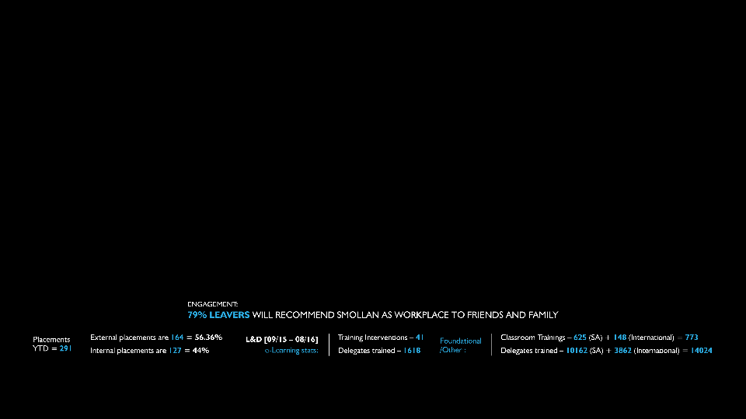
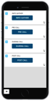
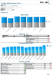

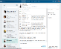


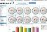

CAPACITY AND CAPABILITY | Human Resources Capability
ALIGN/
ENGAGE
ATTRACT
SKILL
In House Onboarding Training

Slide 19



OPERATIONS, PROCESS, REPORTING AND TECHNOLOGY
24 000 USERS
15 YEARS
+20 COUNTRIES
Smollan has developed and implemented technology and processes internationally that is both relevant and effective in managing, optimising and measuring diverse and large FMCG Field forces of over 24 000 users for the past 15 years in over 20 countries.
We are currently using the Smollan Mobile system in Australia and have the experience of collecting and managing data across our broader group.
In addition to collecting data through mobile systems such as Smollan mobile, we are increasingly incorporating and integrating data from both retailer systems such as the Aztec & Nielsen Portal and also sales out data to give us a full picture of both the achievement and opportunity at store level.

Slide 20
BEST PRACTICE | Reporting and data insights
Utilizing our business intelligence department
Identify / design and implementation of systems reporting and analysis
Integrate Operational / Client and customer information into actionable insights
Drive efficiency, technology and application innovation to support operational excellence

Slide 21
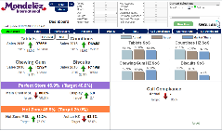

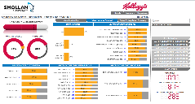
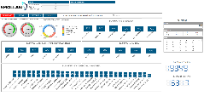
BEST PRACTICE | Reporting and data insights
Reporting Benefits
Task-specific reporting putting business users in the drivers seat
Quick response to market forces and minimize manual efforts
Provide Syncronised access to store performance
Enabling social decision-making through secure, real time collaboration
Call visit compliance & quality of call feedback
Data ingestion

Slide 22
WHAT?
Additional Service Offerings

Slide 23

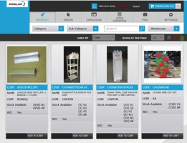

INTEGRATED POS MANAGEMENT SOLUTION
Through WPPAUNZ we utlise Markitforce for all out POS storage & dispatch to field teams
Warehouse locations Nationallally, including Cool Rooms
Intergrated application to our field team – MarkitEzy for ordering of POS materials whilst in store
Further intergrated into Active Display who can develop and produce POS materials

Slide 24
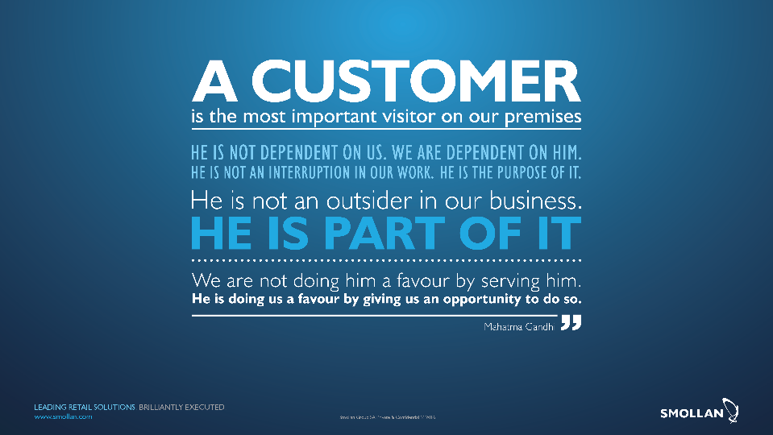

Slide 25
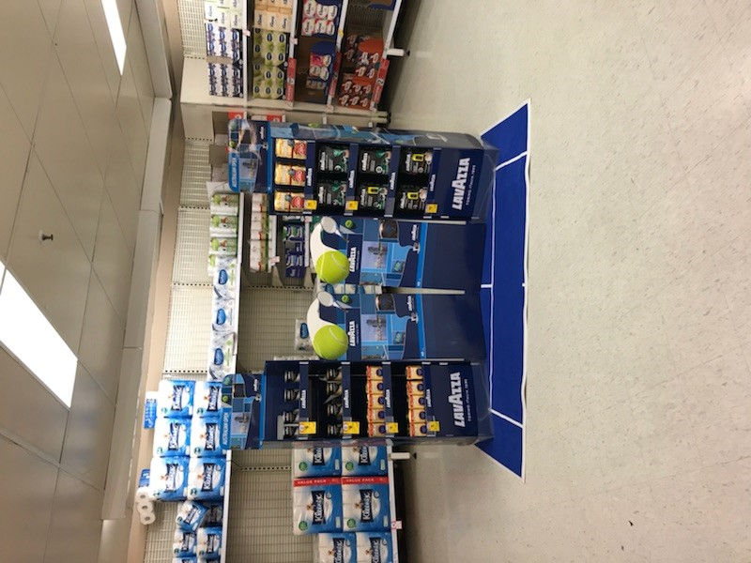
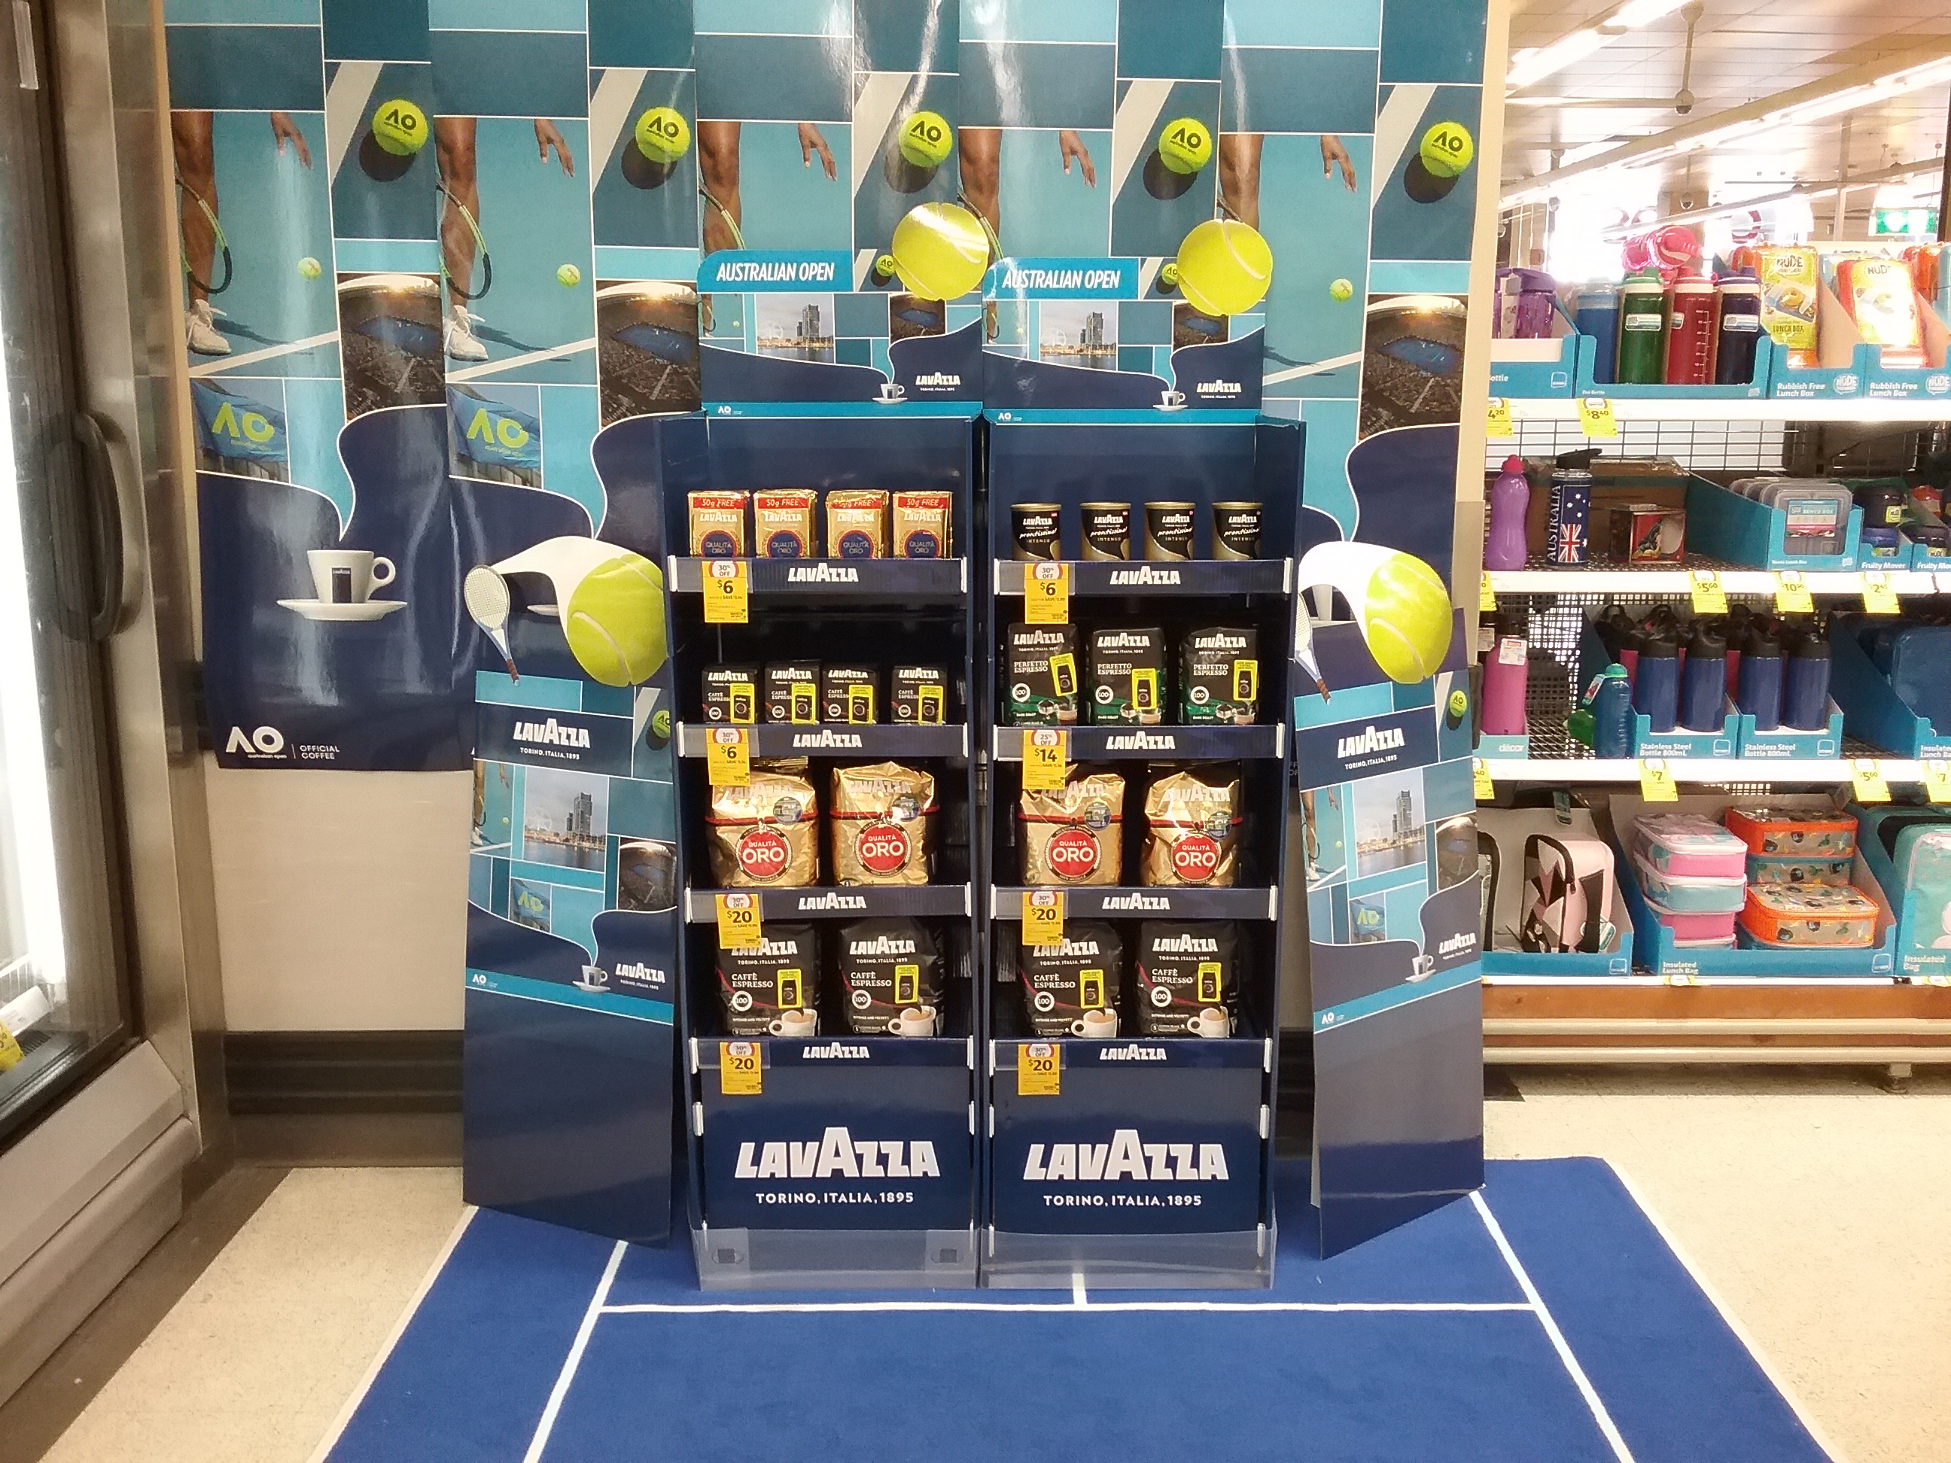
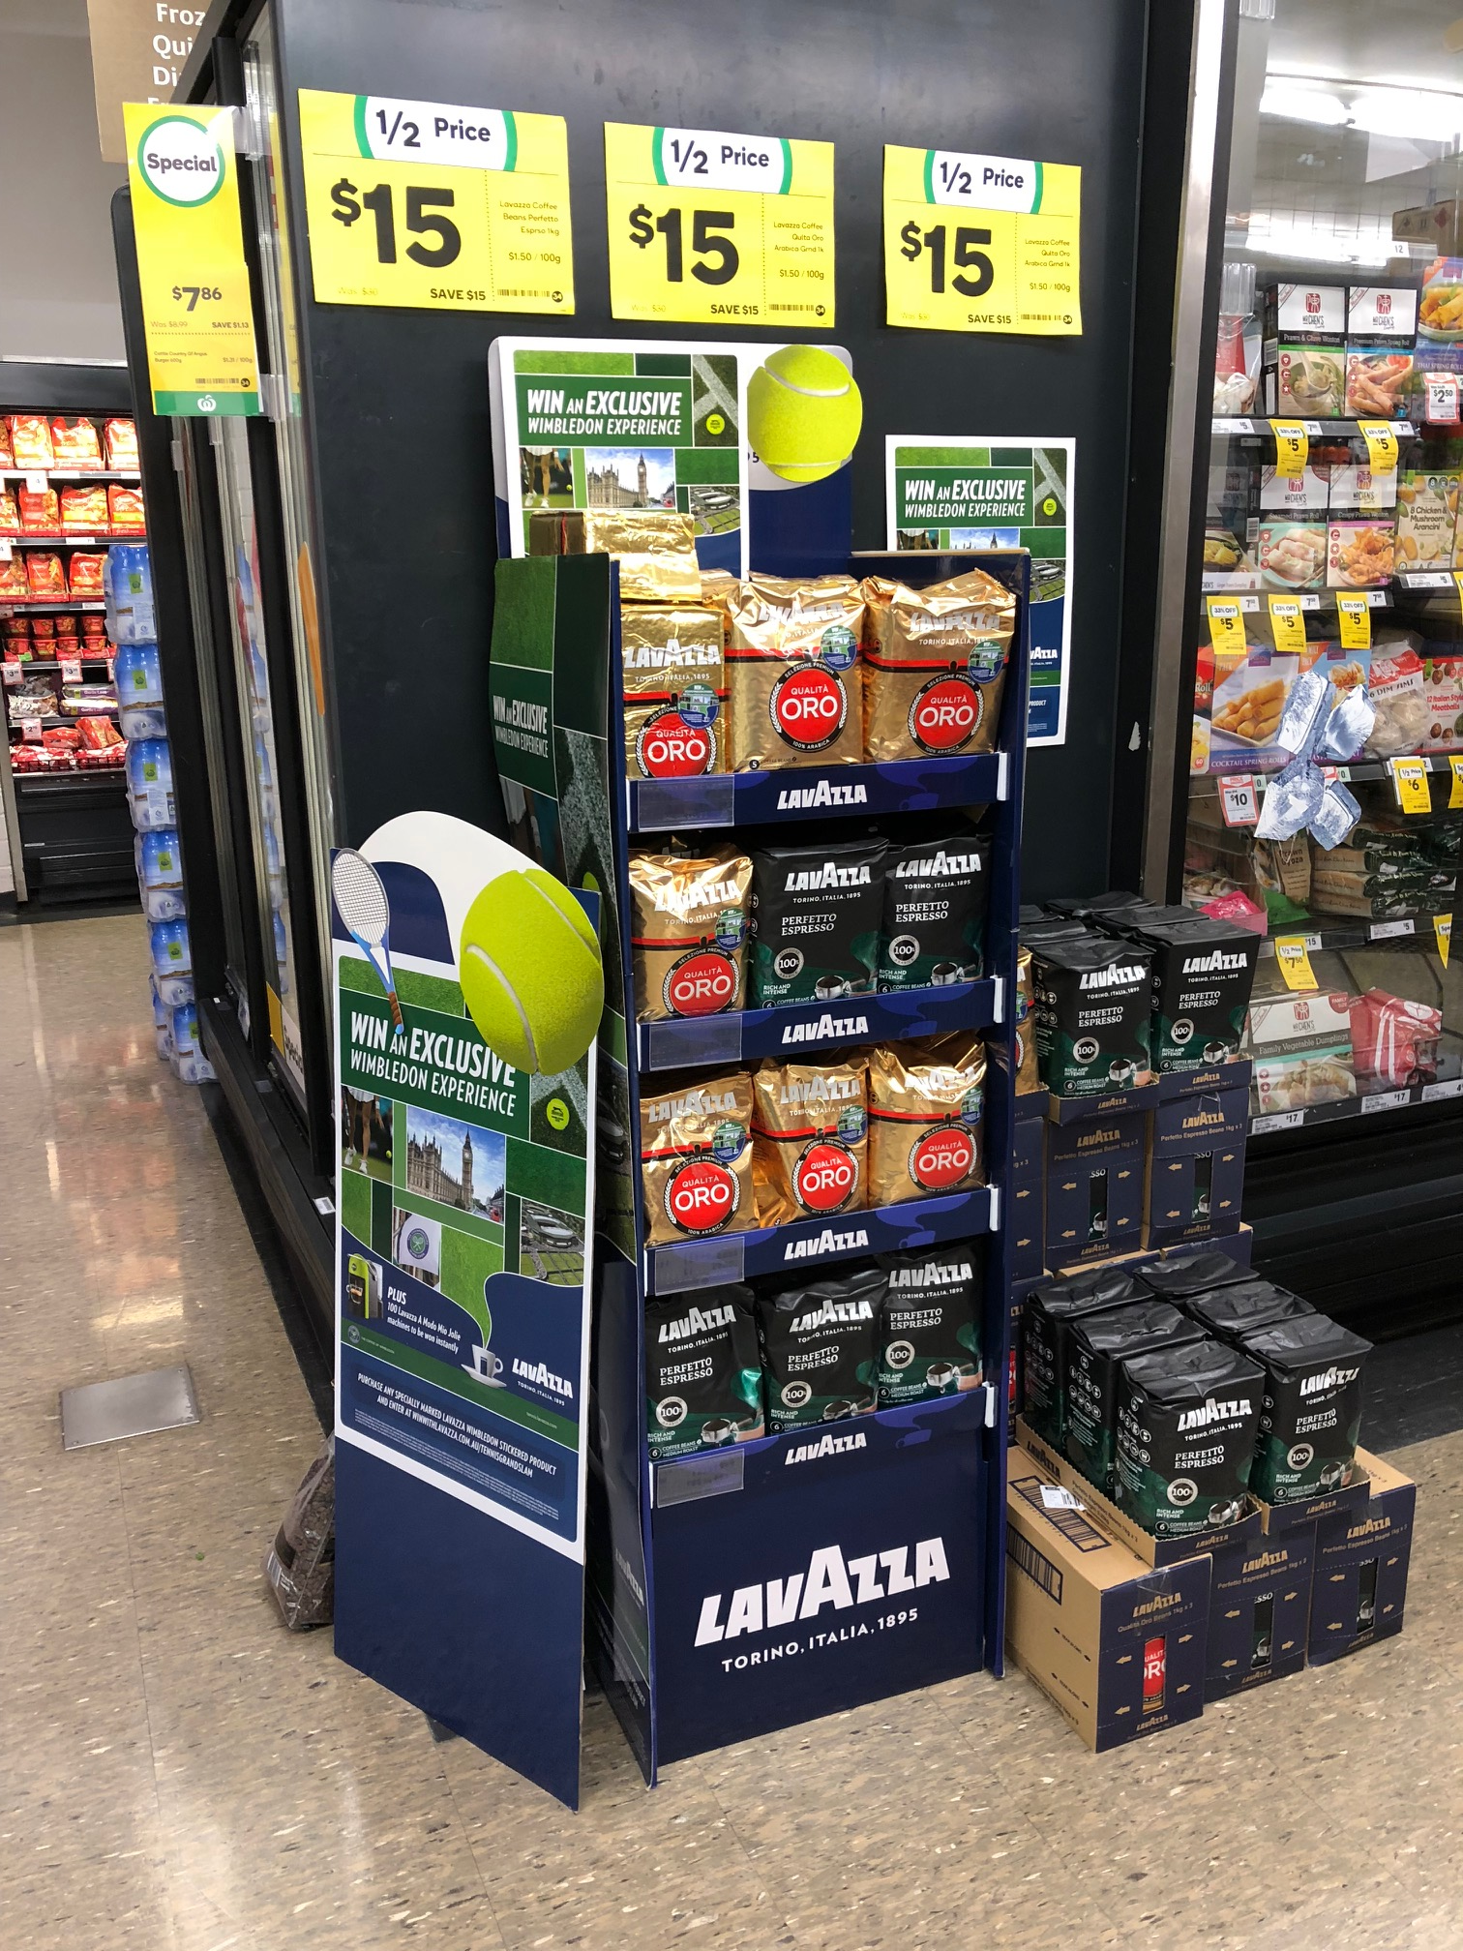
Deliver great service – REACH results for Family VISIT BUILDS JANUARY
Coles RICHMOND
COLES Fitzroy
Coles middle camberwell

Slide 26
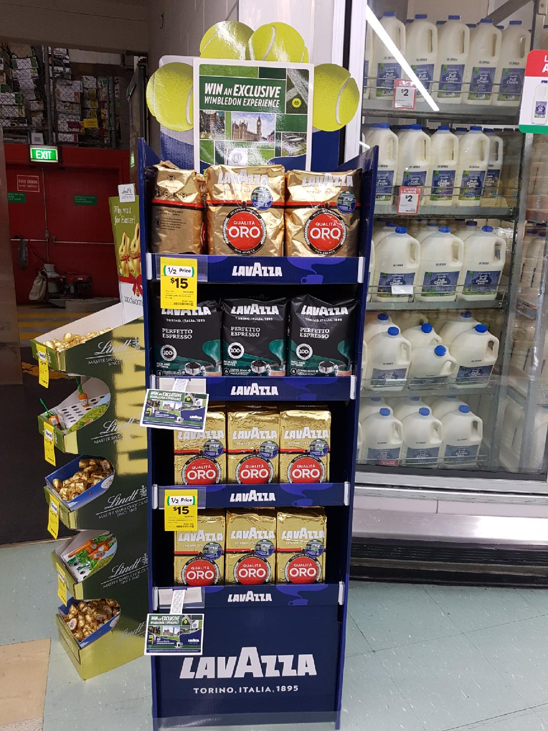
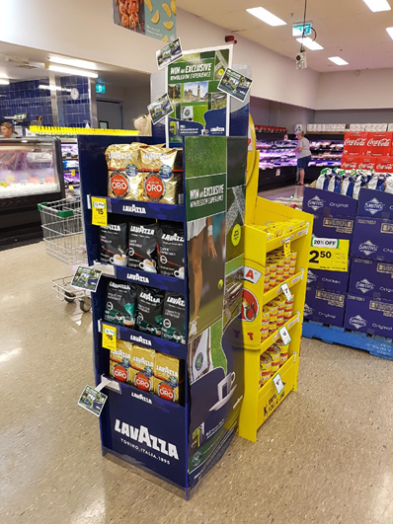
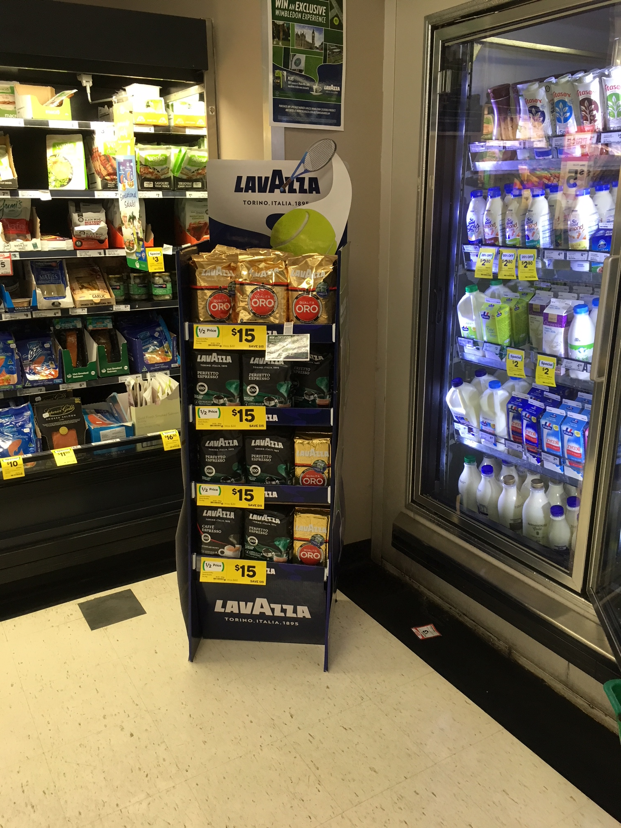
Results orientated: discretional displays ACHIEVED WEEKLY
60 DISCRETIONAL displays ACHIEVE IN
1 WEEK for
ww 1kg 7/2 promotion
Ww Bairnsdale
Iga Castlemaine
Ww Traralgon

Slide 27
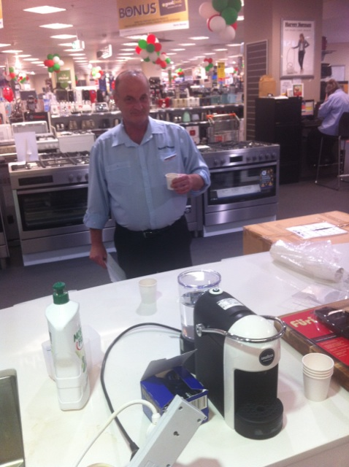
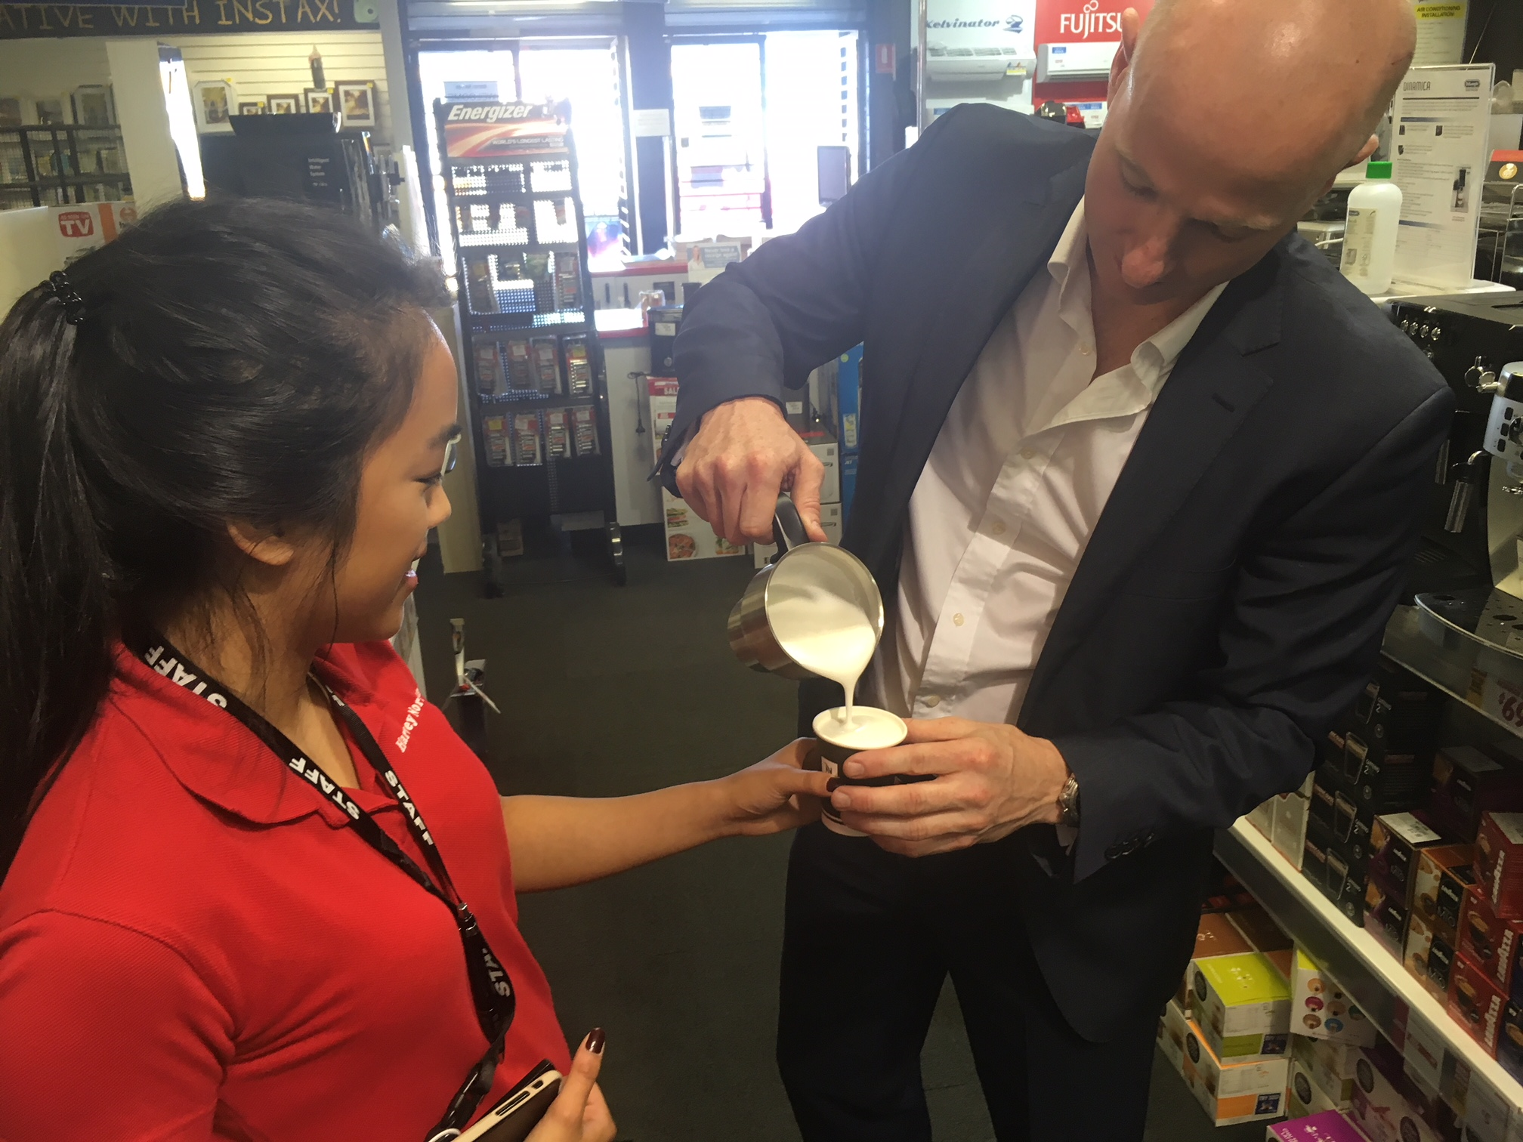
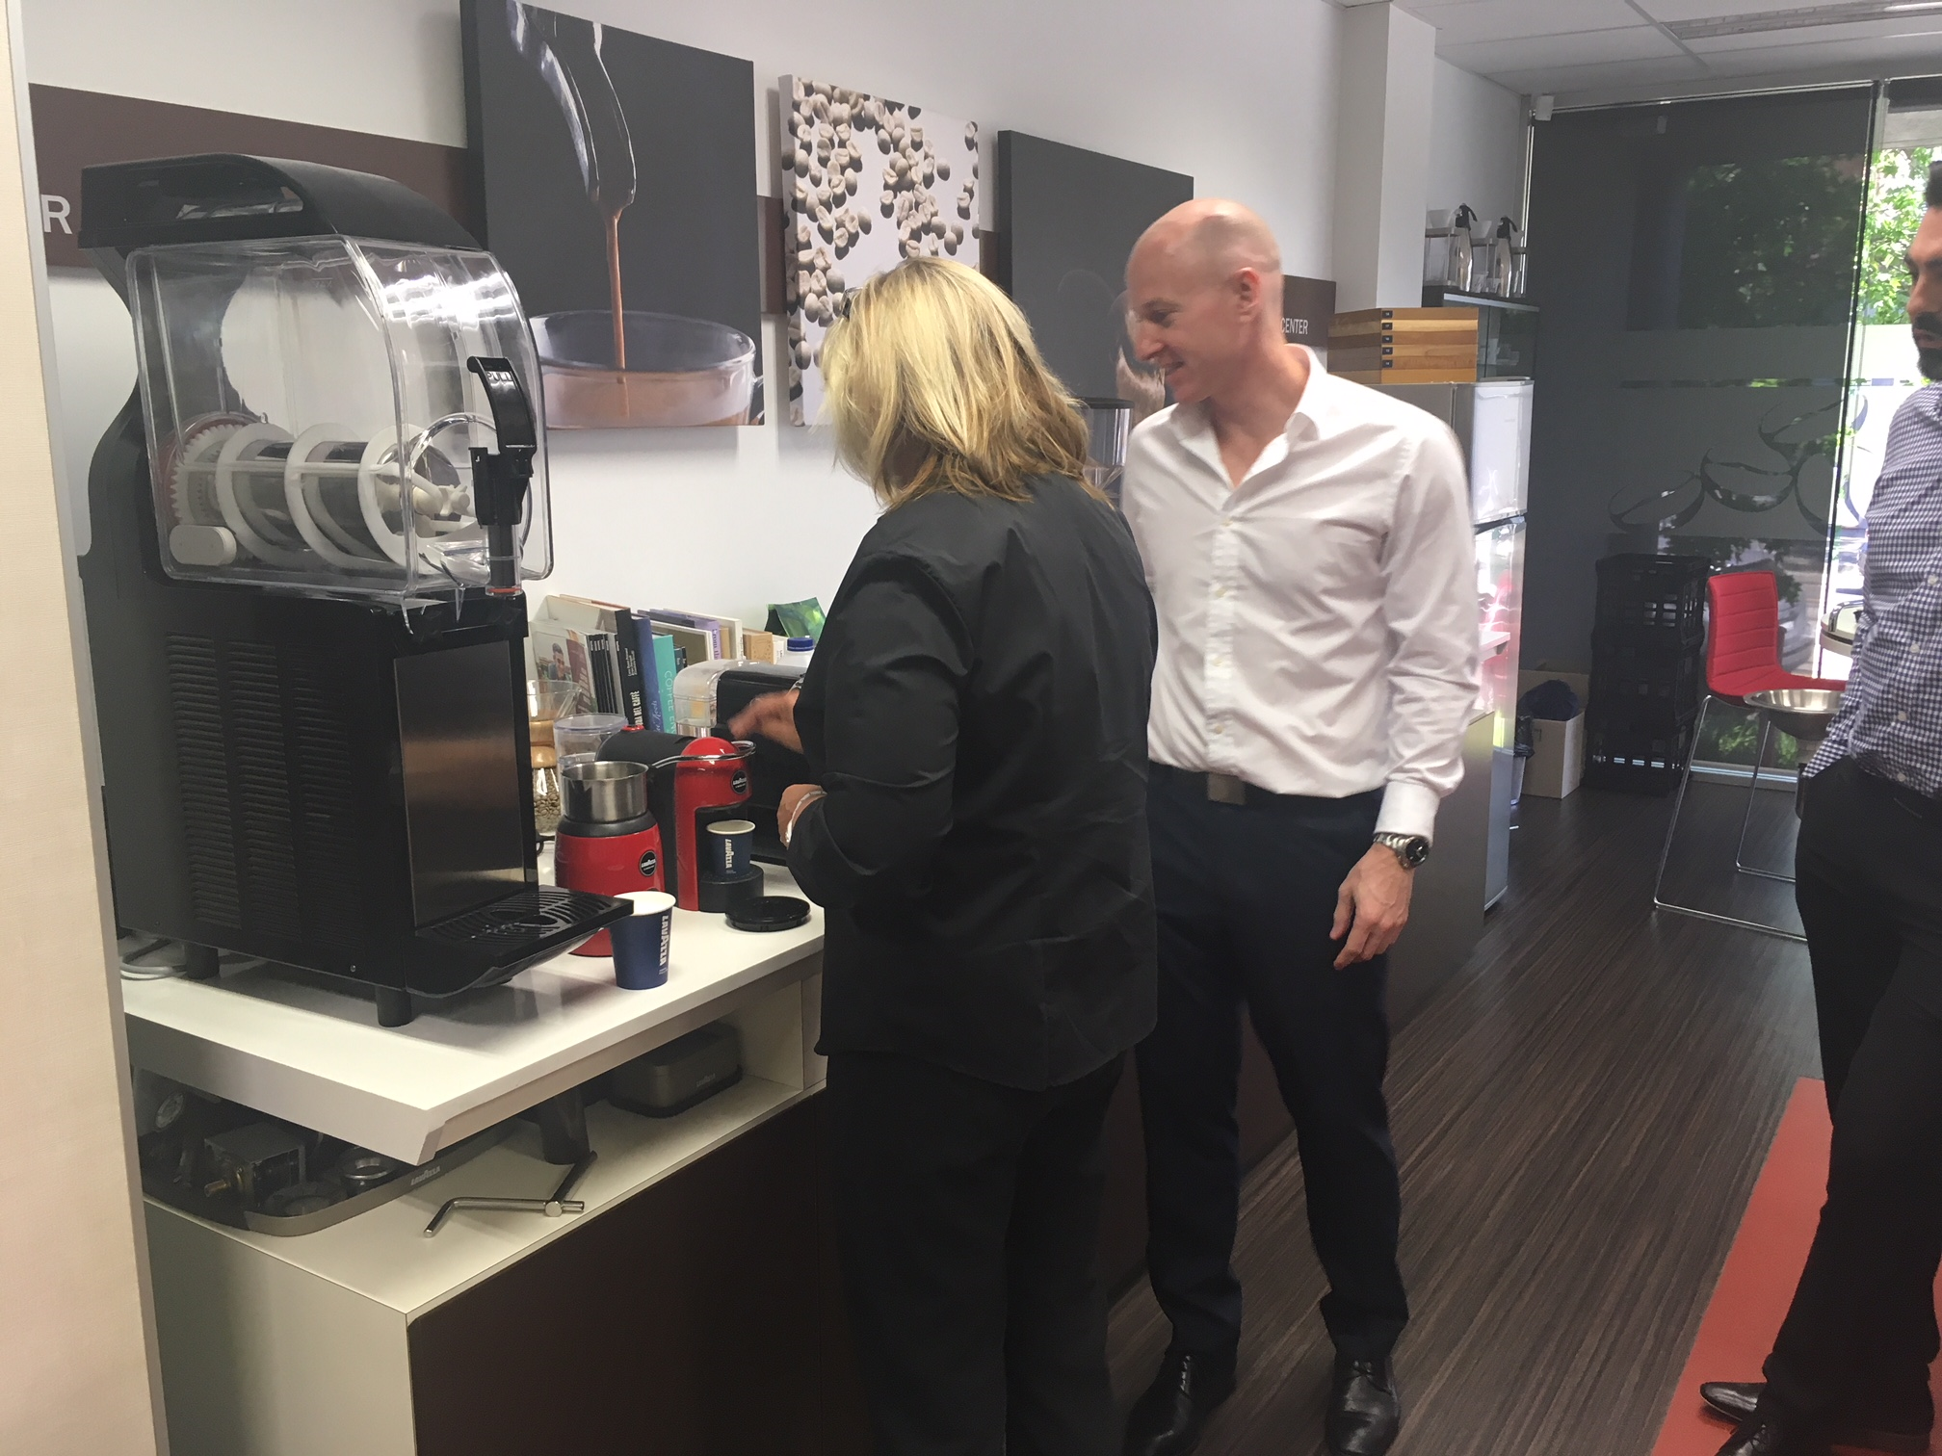
Results orientated: Educating and demonstrating Lavazza in electrical retailers
69 education and demonstration sessions completed BETWEEN OCTOBER 2017 – FEBRUARY 2018
Harvey norman belrose

Slide 28
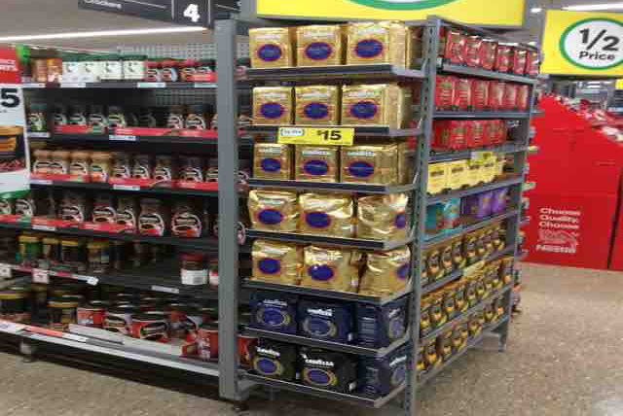
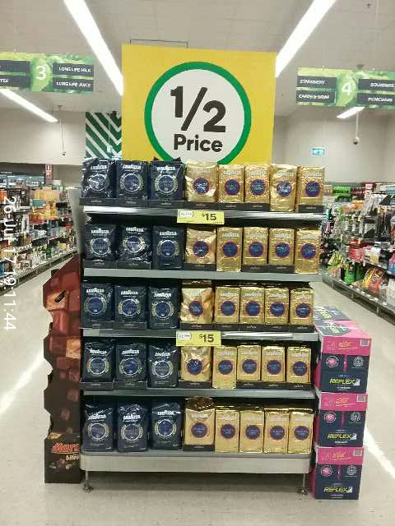
Result orientated: HIGH COMPLIANCE & EXECUTION STANDARDS

Slide 29
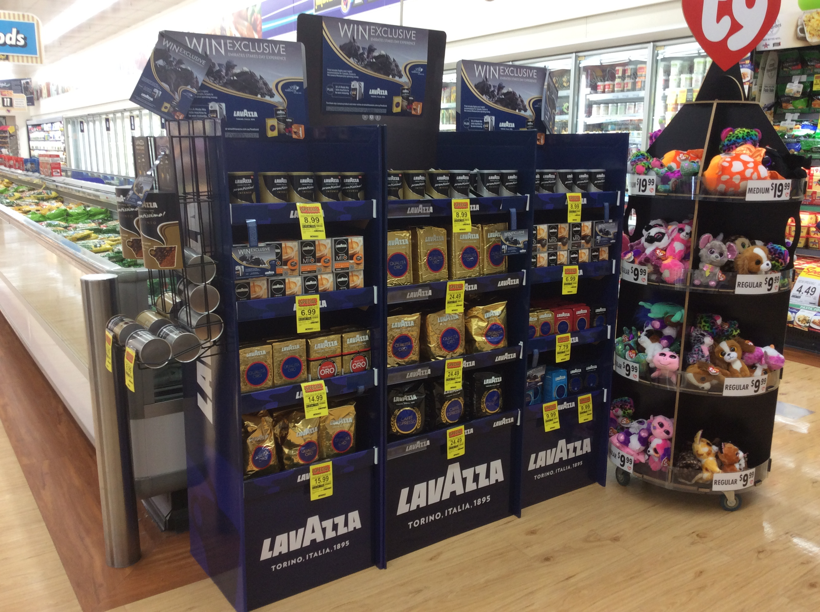
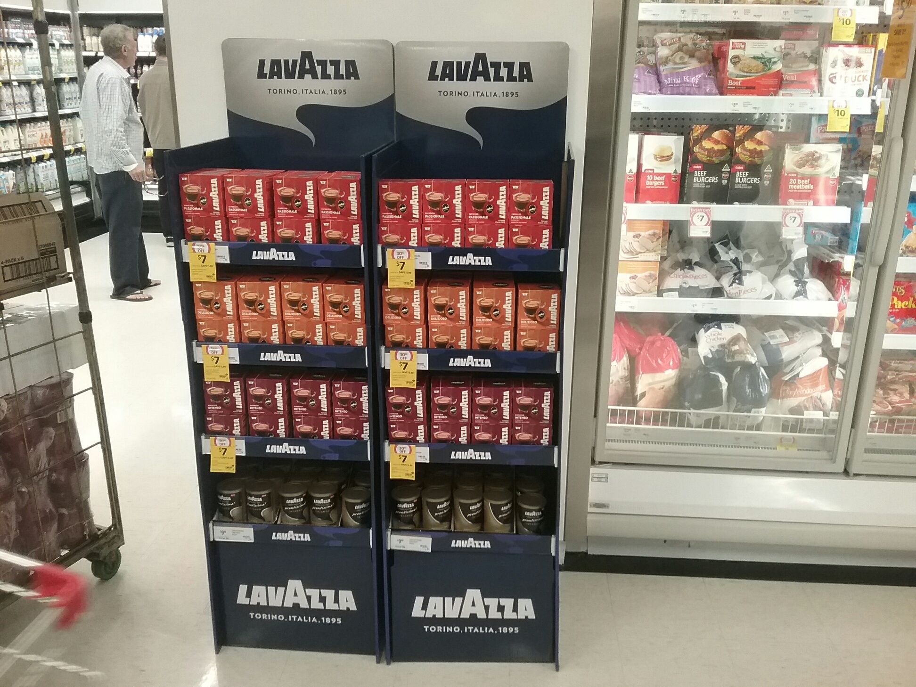
Passion: Upsell to support Lavazza’s promotional programs
Foodland Aldinga
spring carnival competition
Coles Leichardt
sold in additional floor bin

Slide 30
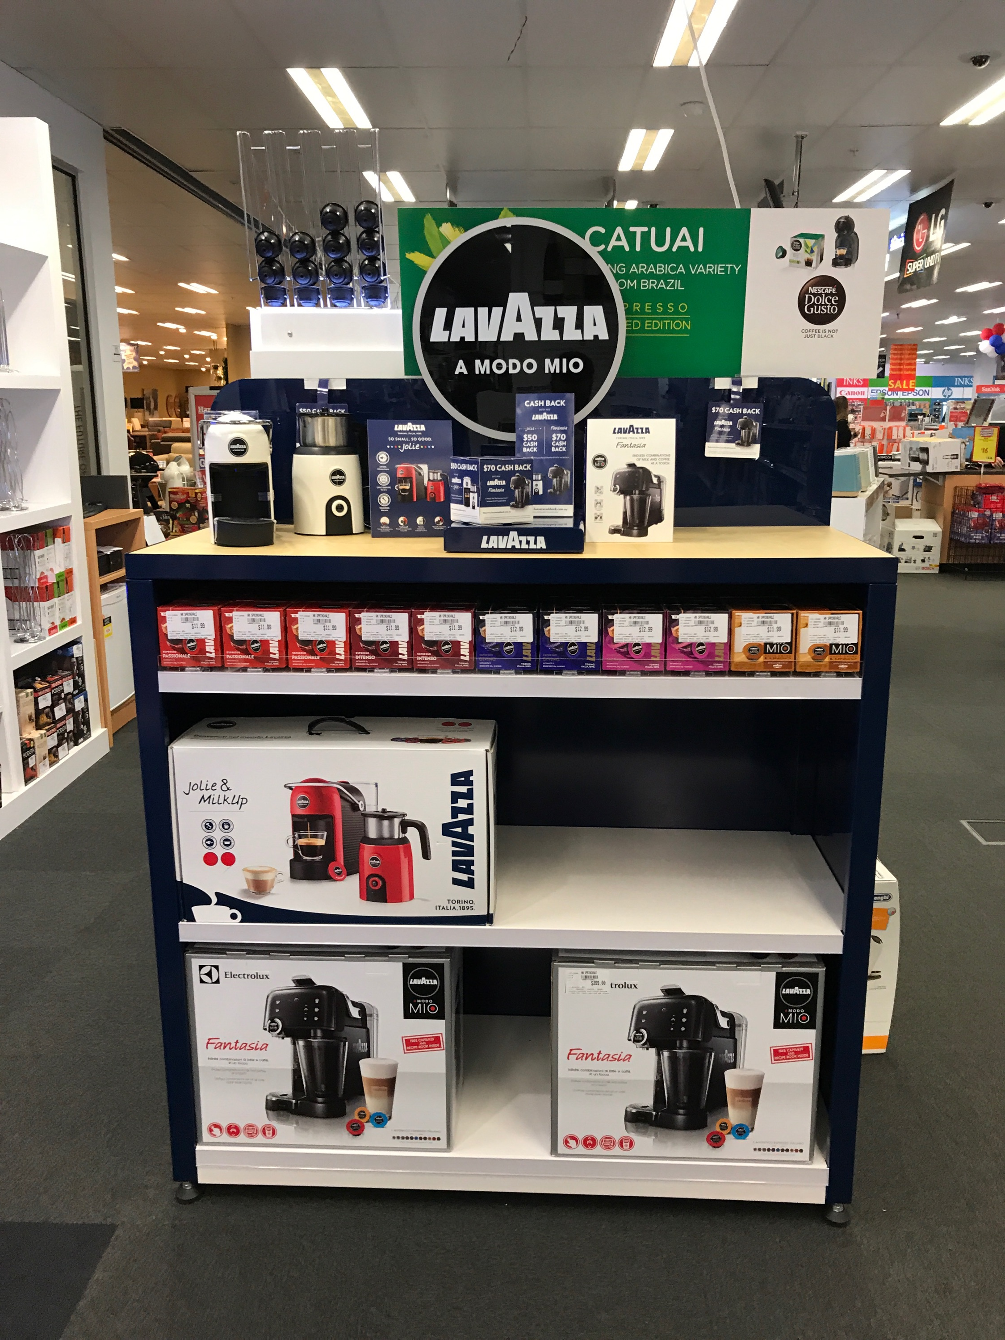
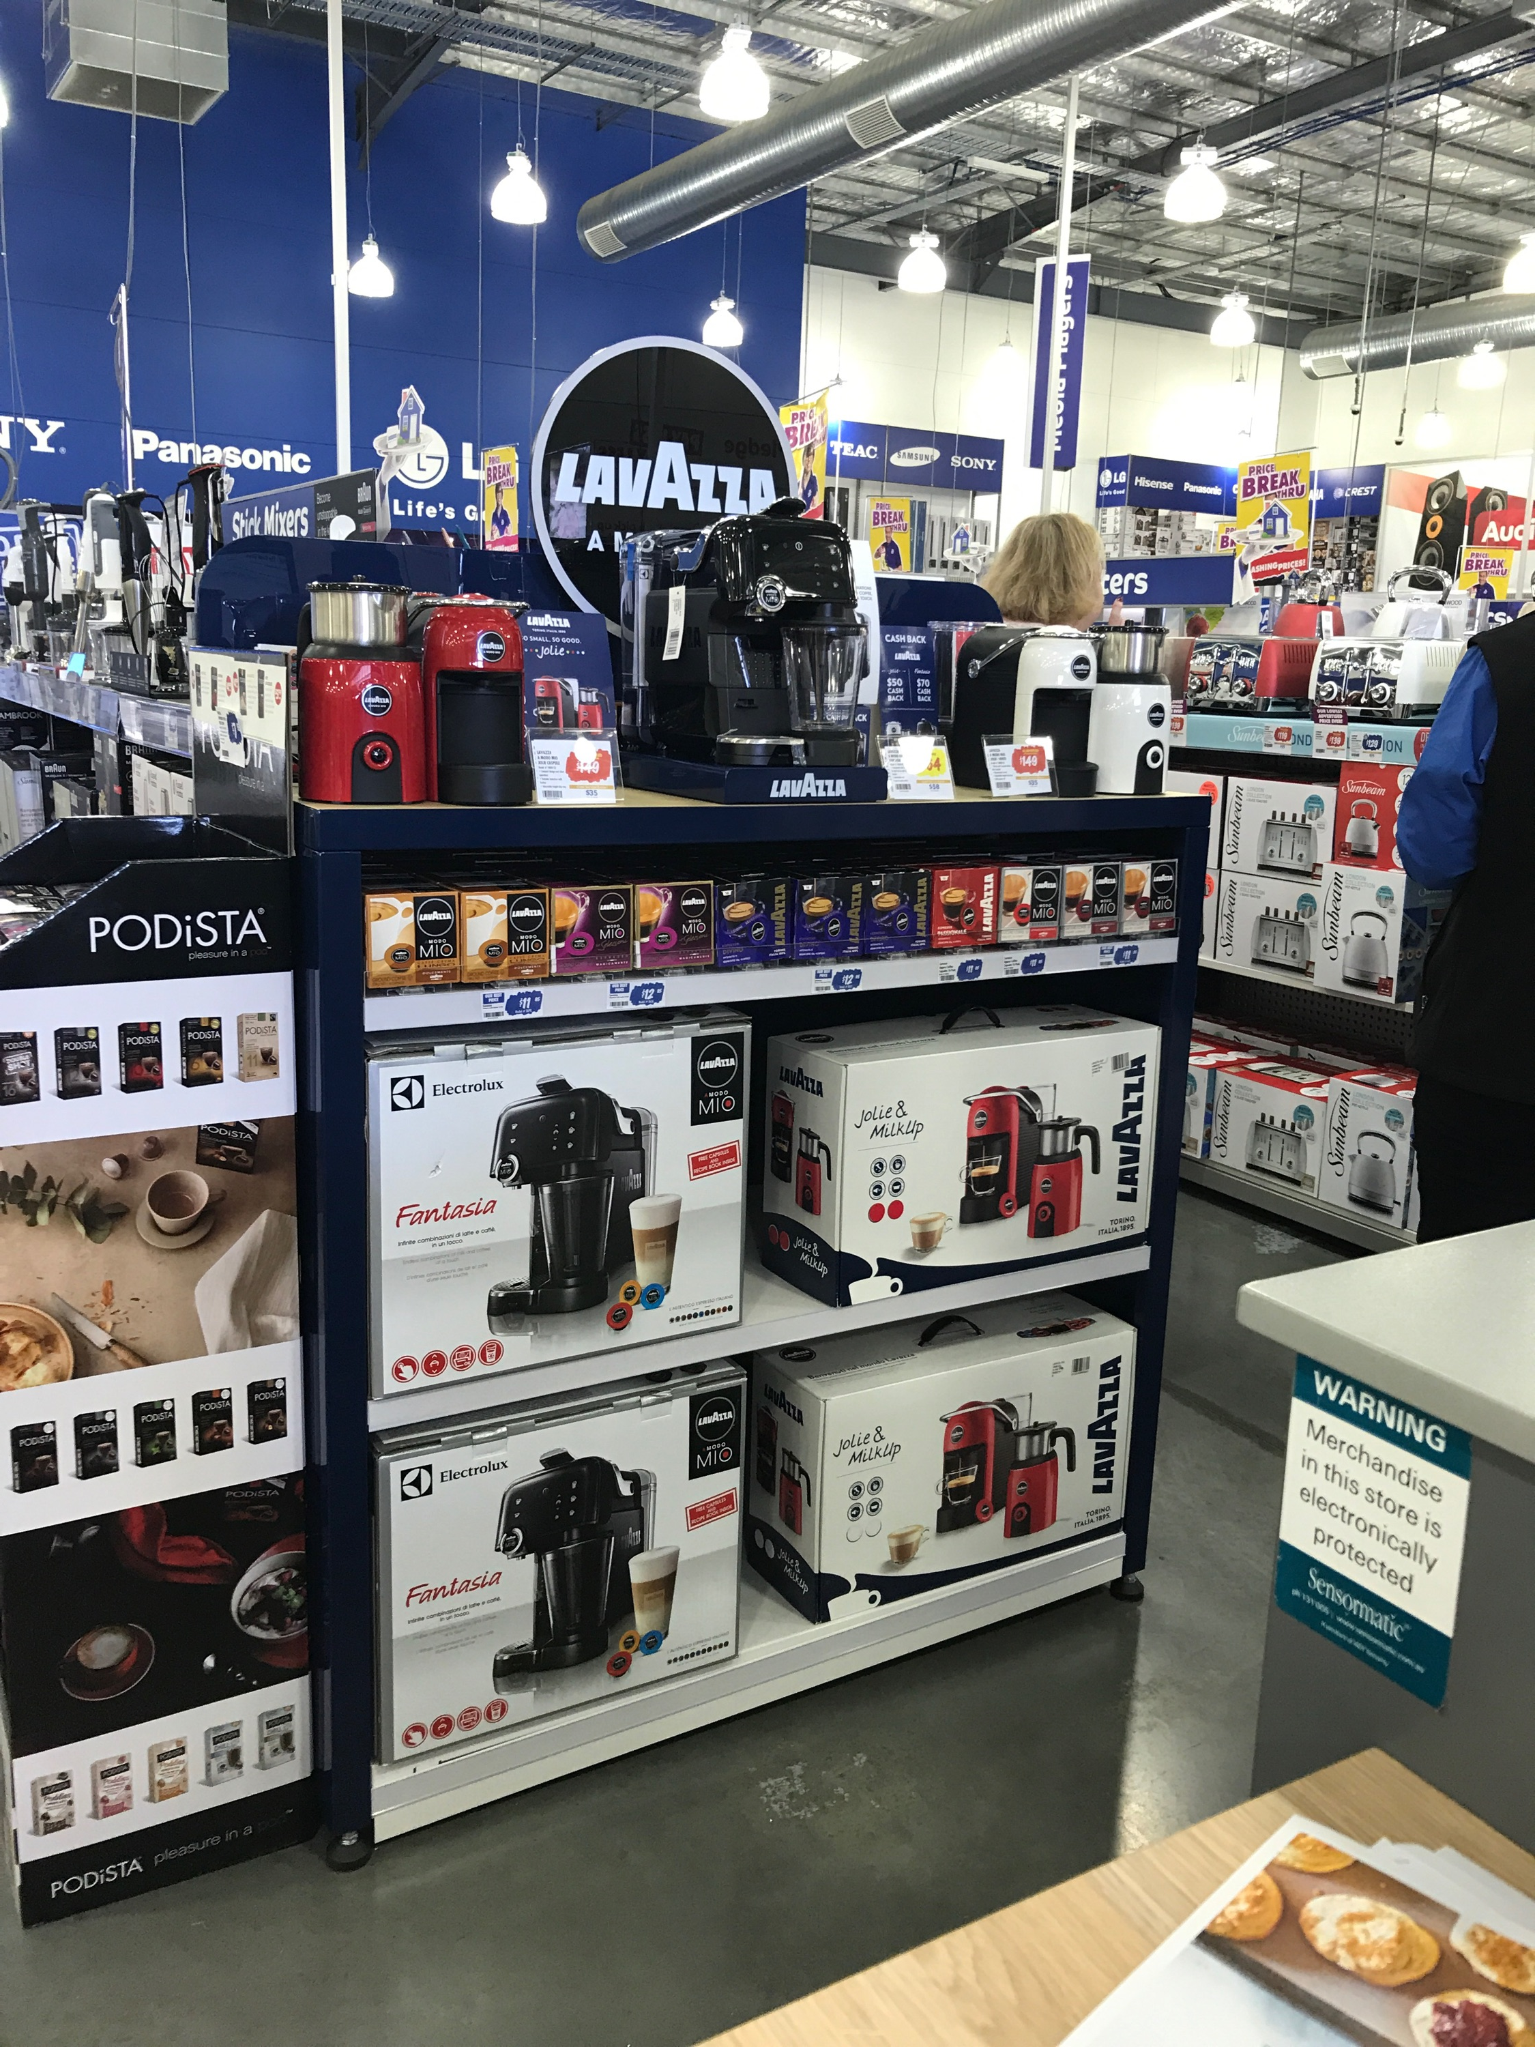
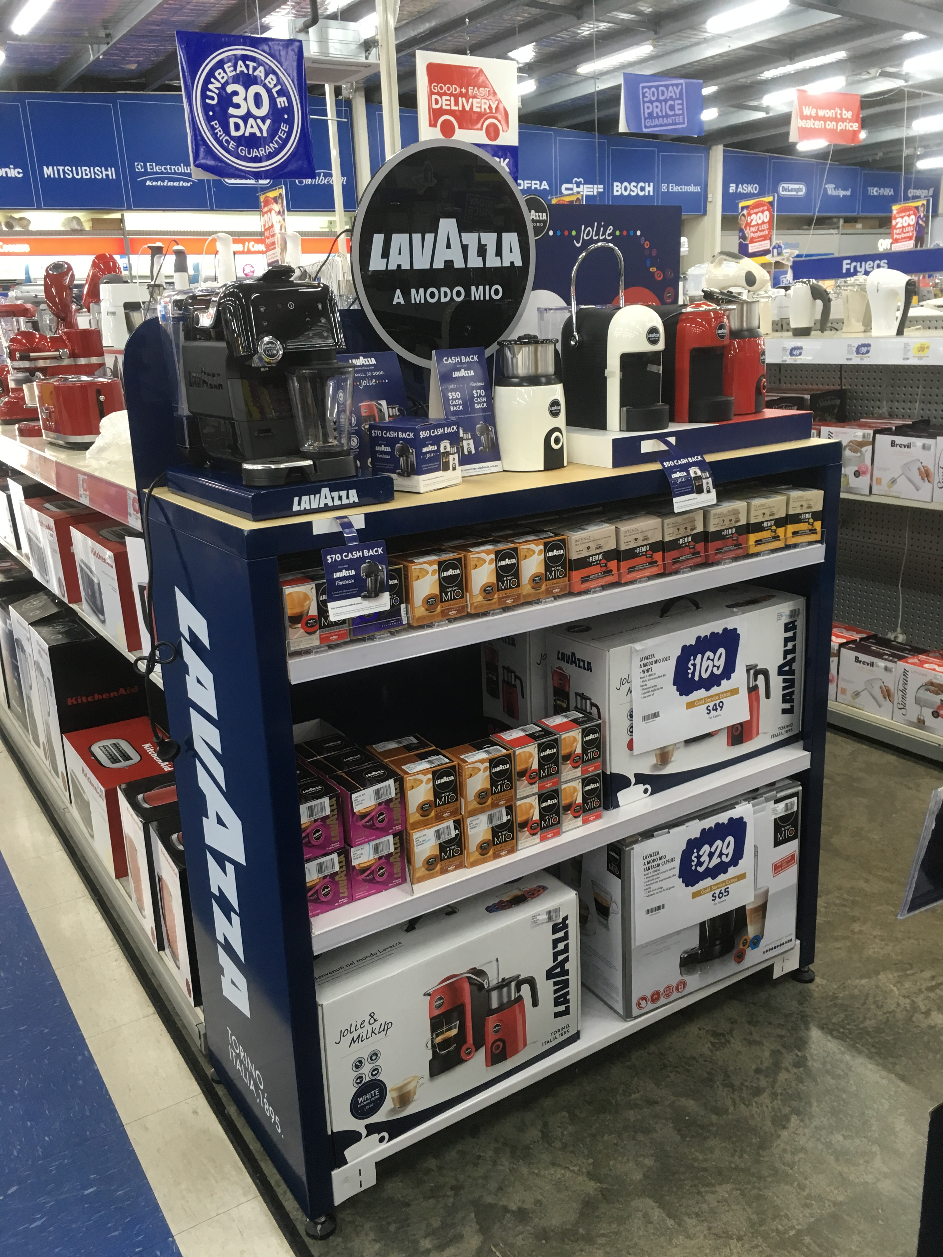
Deliver great service: Building strong relationships and achieving results
6 x Lavazza large table display units sold in to electrical retailers
Harvey norman springvale
Good guys Dandenong
Good Guys Taraglon

Slide 31
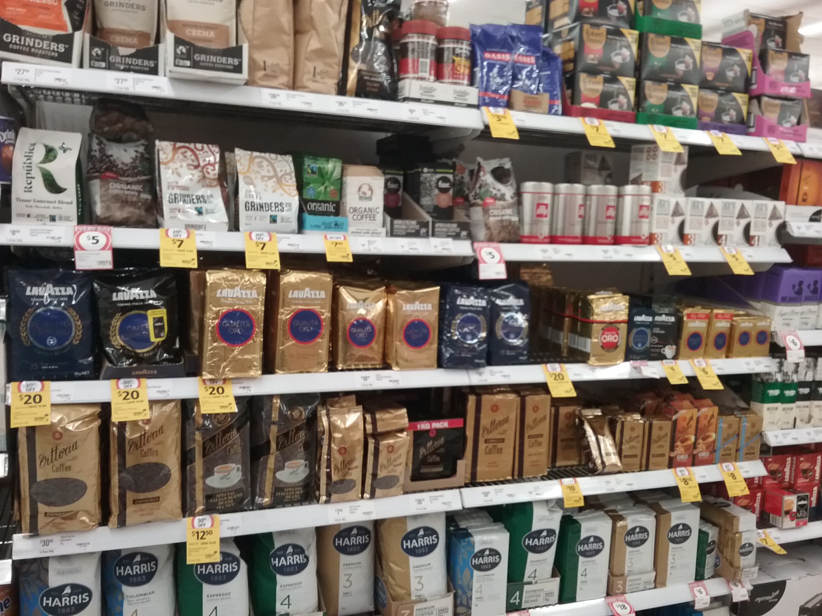
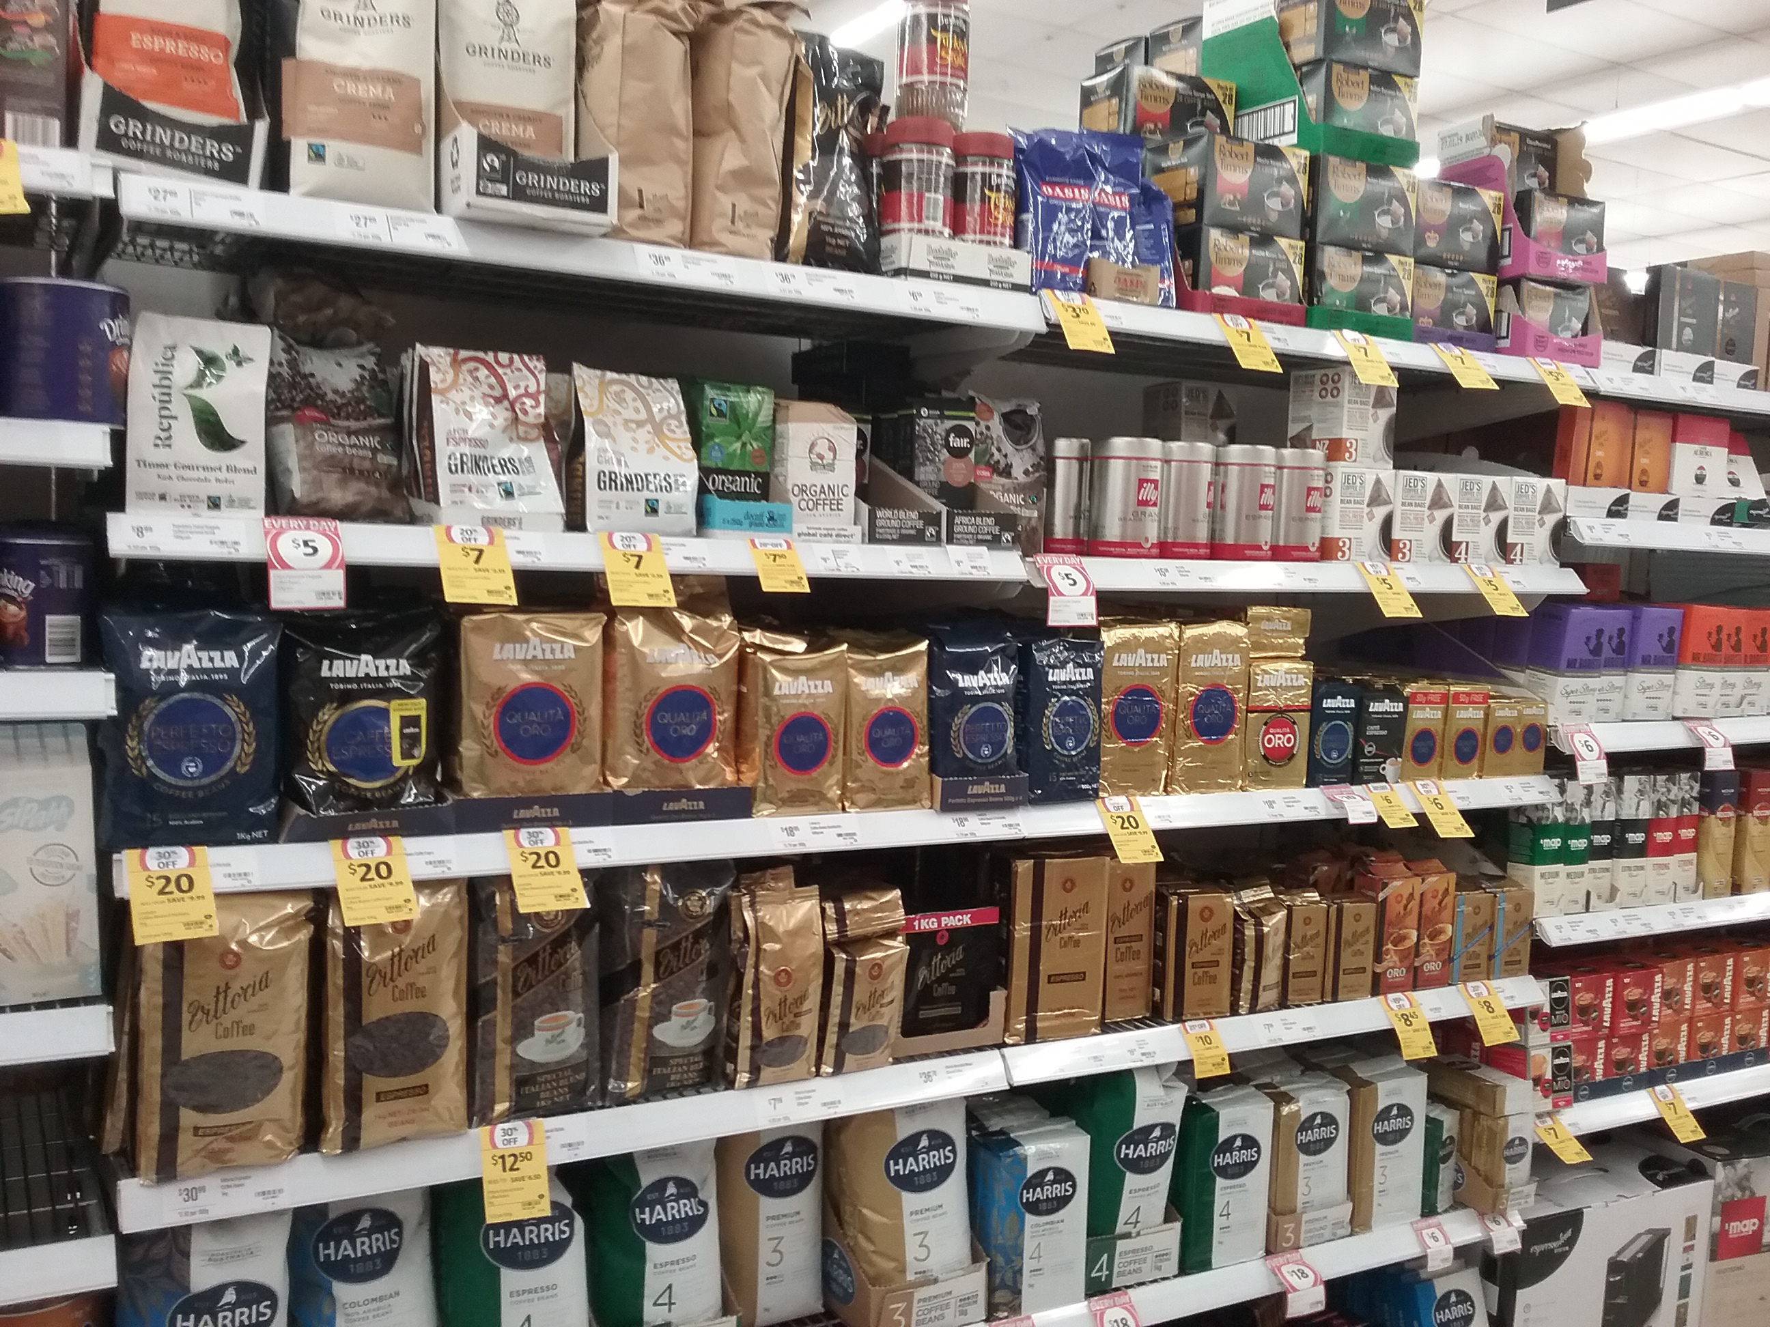
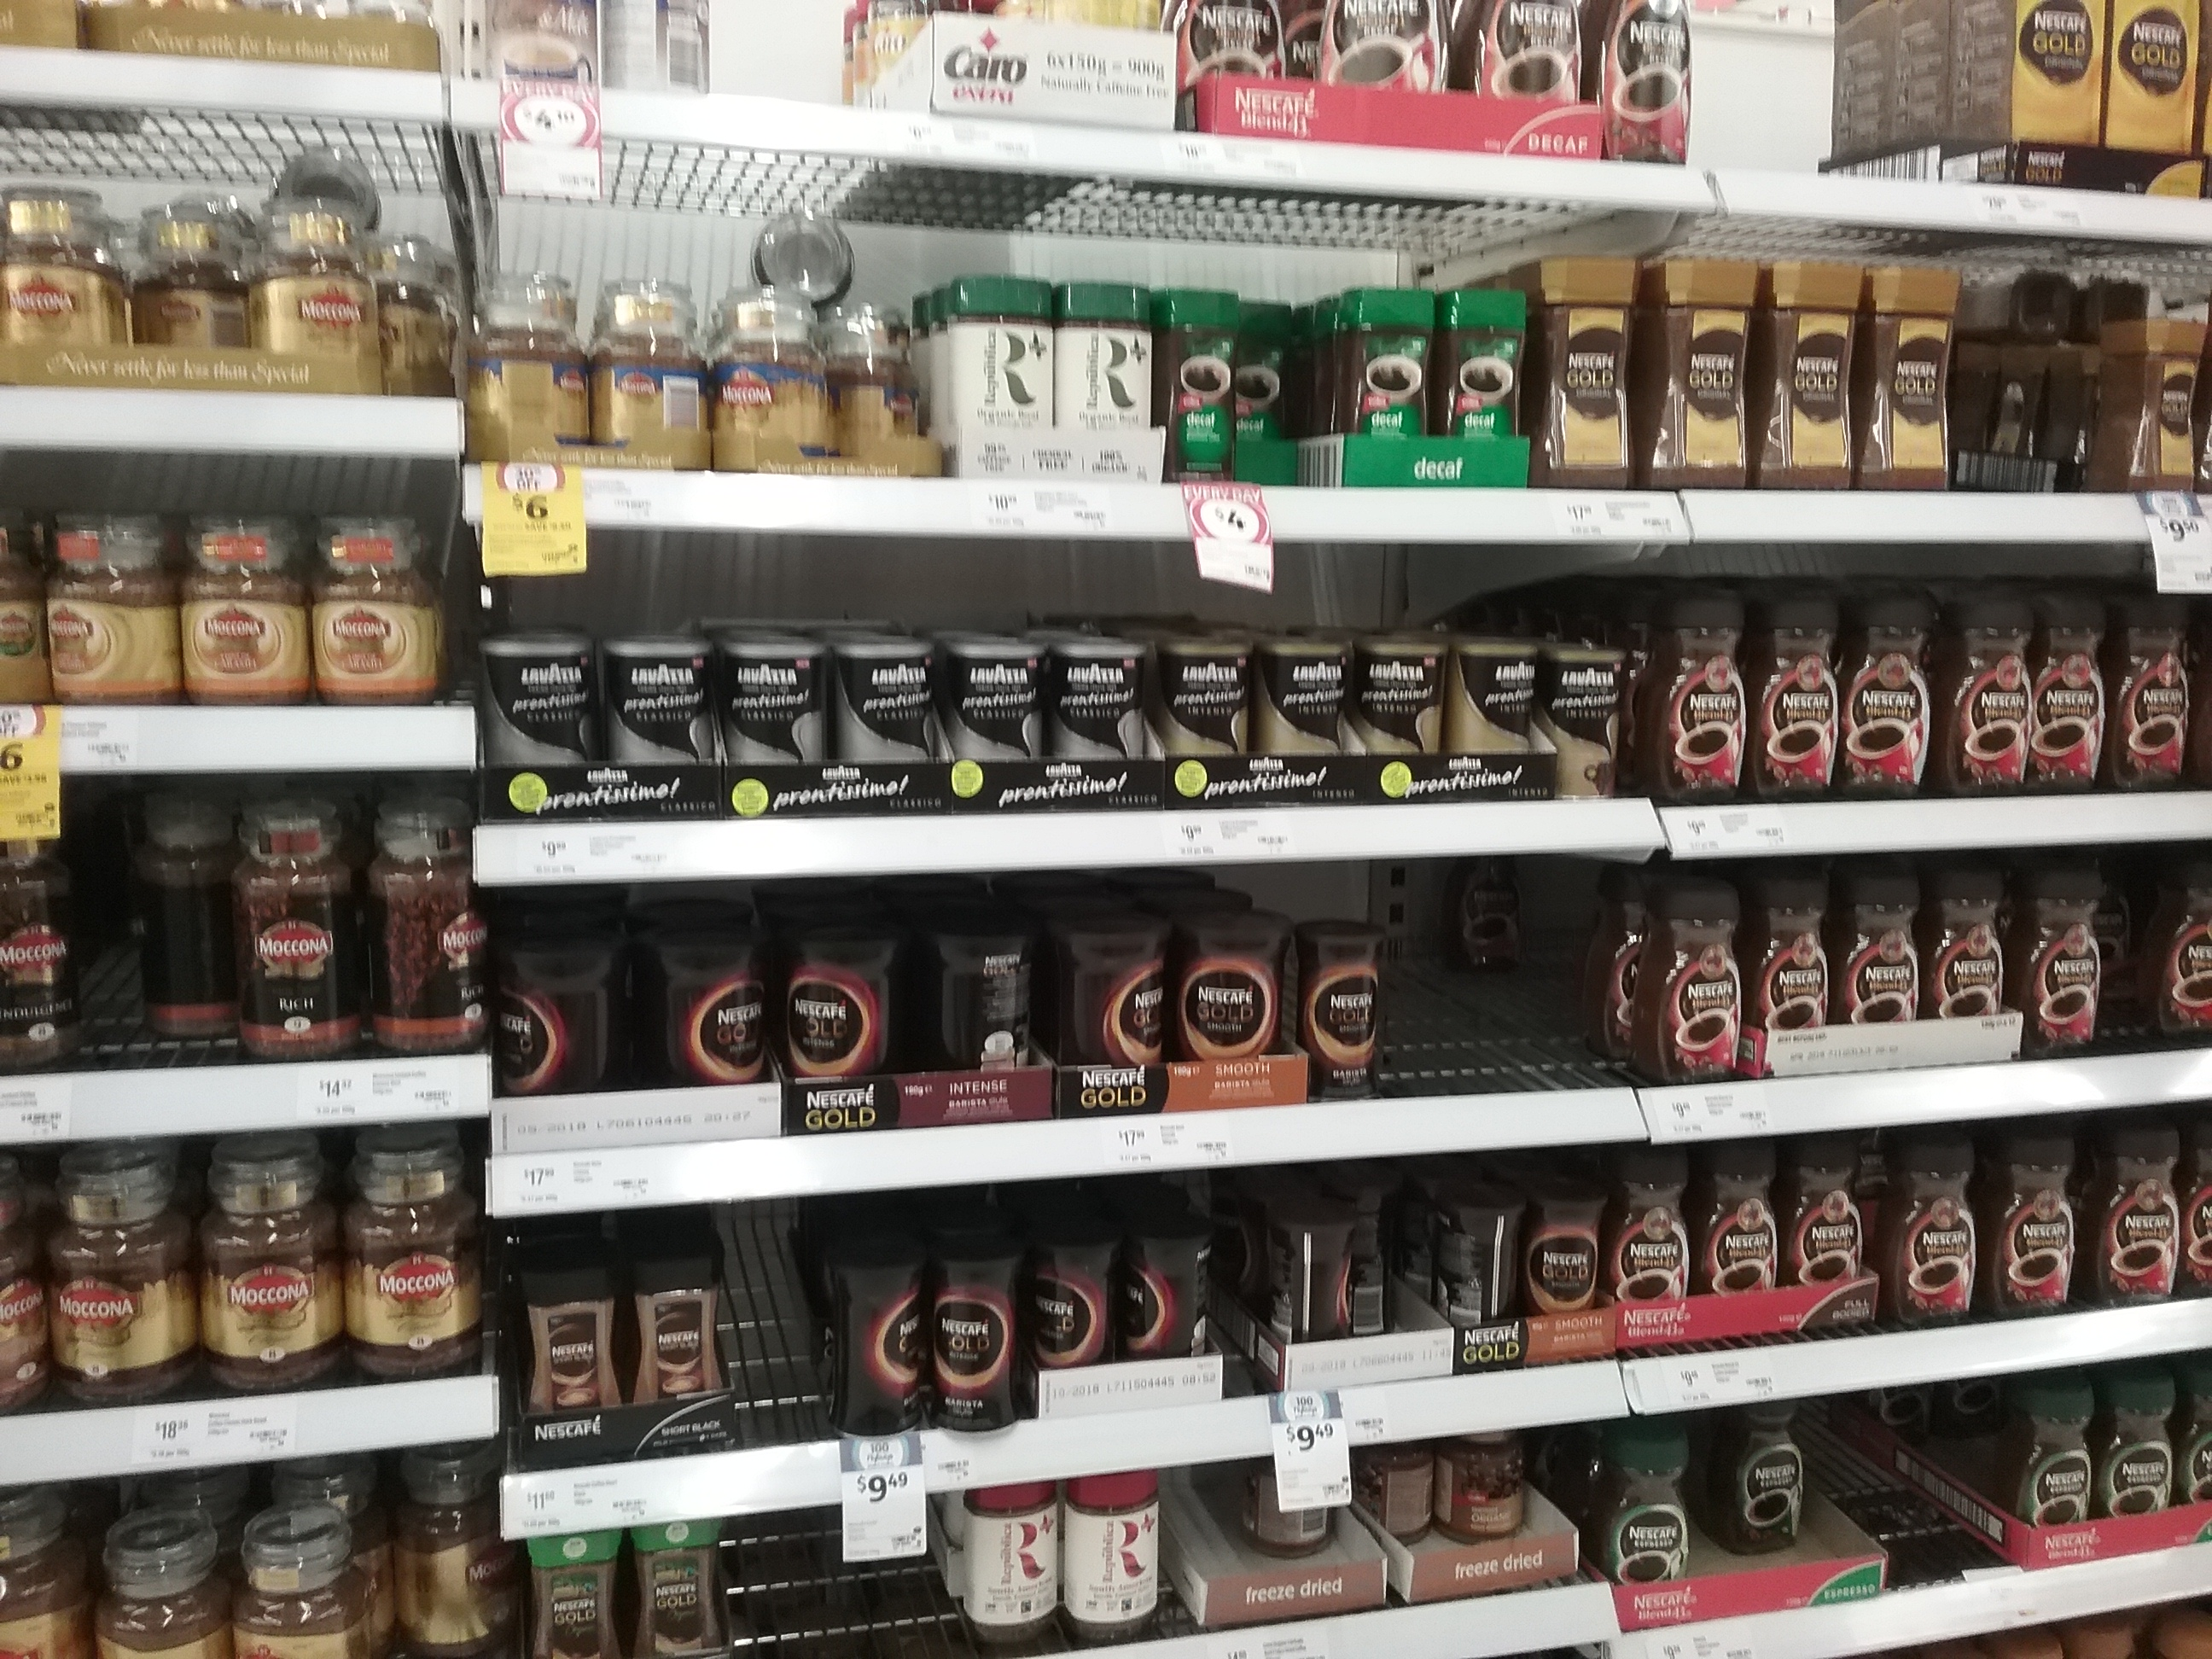
DELIVERABLES: Effective on every store visit – example coles north lakes
Before & After
Fixed Lavazza 1kg ground gold packed into beans and ground oos
Fixed Lavazza 1kg Ground, back to two facings
GM Deepak, has placed an order for more 1kg to arrive for me to fill following Monday
Opened up 250g Perfetto
Removed 2 cut Lavazza 1kg Gold Ground from fixture
Placed PRONTISSIMO stickers and faced
tidied Lavazza caps
Filled & Tidied front end shelf

